Slide 1
The Battle of Neighbourhoods
Mumbai, India

Slide 2
Table of Content
Introduction
Data
Methodology
Results
Discussion
Conclusion

Slide 3
Introduction
This presentation covers the major aspects of a study done as a part of specialization certification for Data Science provided by IBM.
Here, we have tried to apply all the knowledge acquired in the courses so far to enhance understanding of the subject matter as well as to gain some real life experience on working on a data science project.
In this study we will focus on Mumbai city of India and different venues in it.
We will then dive deeper to group venues in categories and segregate different areas of the city using data science methodologies.
As we are slowly getting back towards normal after pandemic, we need to provide a detailed study of different venues and their categories as well as which corners of the city to find them in.

Slide 4
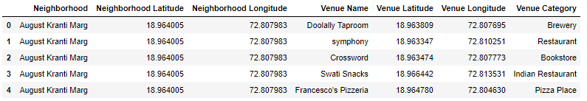
Data
We will collect data about neighborhoods and their pin codes in Mumbai from a website.
Then we will use Four Square API to get near by venues for each neighborhood with their co-ordinates and category.
Then we will prepare data with neighborhood with top 10 most occurring venues for that neighborhood by applying data analysis techniques in Python.
The figure shows final data frame used for machine learning

Slide 5
Methodology
We used K-means clustering algorithm for clustering various neighborhoods in to 10 clusters.
The flow shown here shows the process of K-means algorithm.
First it selects random K centroids in n-dimensional space where K is an arbitrary number and n is number of features.
It then segregates data points and labels them according to the nearest arbitrary centroid.
When the labelling is completed for all data points, the centroids are moved to mean of the data points in their respective clusters.
The same process is repeated with these newly obtained centroids and stopped when there is no change possible further.

Slide 6
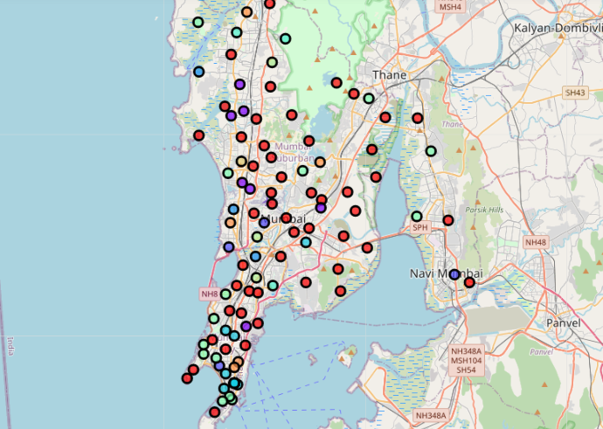
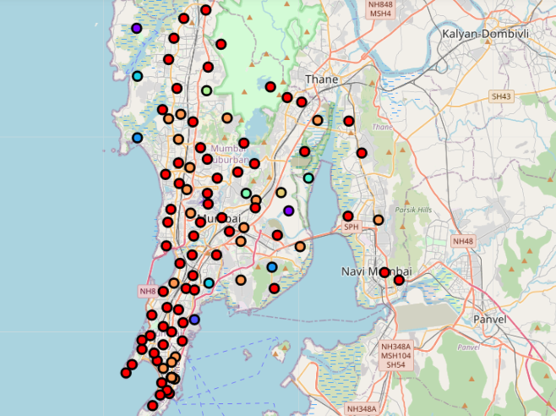
Results
Clustering map for outing and recreational places
Clustering map for food venues

Slide 7
Discussion
In both the cases, what we have observed is, the categories with highest number of venues across the city have major impact on clustering.
These categories cause imbalanced clustering and we could observe over presence of venues of these categories in clusters with higher number of neighbourhoods.
In Case 1 'Multiplex', 'Cricket Ground' and 'Movie Theater' has the highest frequency and as it can be seen they are everywhere in Cluster 4 and 6 which are Clusters with maximum neighbourhoods.
In Case 2 'Indian Restaurant' and 'Cafe' has the highest frequency and as it can be seen they are everywhere in Cluster 0 and 9 which are Clusters with maximum neighbourhoods.

Slide 8
Continue…
An important point to note here is, in both cases we have a cluster named ‘11.0’ for those neighbourhoods with zero venues that fall under selected categories.
Ironic that a city like Mumbai has 5 neighbourhoods with zero food places and 41 neighbourhoods with zero fun places!!
This might be a result of inefficient data registration or limited access for available licence in Four Square API.

Slide 9
Conclusion
This study has provided credible and considerable amount of hands-on experience for data mining, data analysis, data visualization and machine learning algorithm over a real life problem.
We can further optimize the clustering by adjusting K value using Elbow method and see how we obtain different results.
We can carry out same analysis for more such categories like healthcare, banking etc. and see which area is all over the best in Mumbai with everything available 5 steps away.

Slide 10
Thank You

